Slide 1
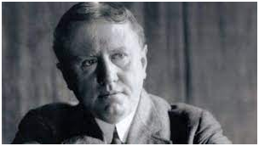
The Gift of Magi By O. Henry
bookriot.com(google images)
Jukkalkar Syed Imtiaz
Shri Shivaji Science & Arts College, Chikhli
William Sidney Porter (1862-1910) wrote under the
pseudonym O Henry.
He is one of the most prolific short story writer of
America. There are more than 600 short stories his credit.
In 1896, he was falsely implicated in a case related to
embezzlement of bank funds.
While serving his sentence in the penitentiary at
Columbus, Ohio, to earn money to support
his daughter, Margaret, he started writing short stories.
The stories became a great hit with the magazine readers.
By the time he was released from jail,
he had become a short story writer of repute.
His stories are mostly concerned with the
lives of the common people in New York.
Humour, gentle irony and surprising endings are
special features of O Henry’s short stories.

Slide 2
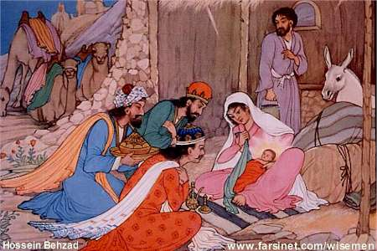
Significance of the Title - The Gift of Magi
The reference of Magi in the title is taken from the Bible.
As per the biblical story, Mother Mary and St. Joseph travelled to Bethlehem. They tried to seek refuge in an inn but the innkeeper turned them away. At last they stayed in a barn where Jesus was born and laid in a manger.
Jesus took birth in Jerusalem, Israel.
Then the Magi visited them.
The Biblical Magi are also known as the Three Wise Men, or The Three Kings who visited the infant Jesus after his birth and gave gifts of gold, frankincense. .
FarsiNet.Inc (google images)

Slide 3
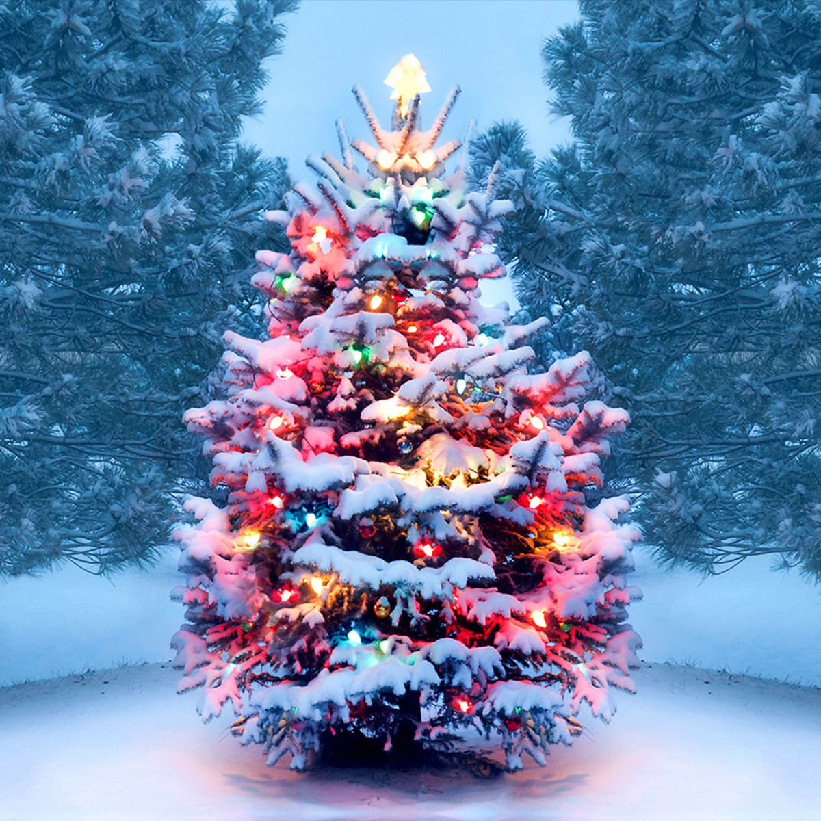
One Dollar and Eighty Seven Cents.
James Dillingham (Jim)
Della Dillingham (Della)
American Currency
100 cents is equal to 1 Dollar
Penny = 1 Cent
Nickel = 5 cents
Dime = 10 Cents
Quarter = 25 cents
Half Dollar = 50 Cents
Golden Dollar = 1 Dollar
One dollar and eighty seven cents
Sixty cents were in Pennies.
These pennies were saved by bulldozing the grocer, the vegetable man and the butcher.
Three times Della counted the money.
The next day is Christmas.
Christmas is an annual festival commemorating the birth of Jesus Christ, observed primarily on December 25 as a religious and cultural celebration by billions of people around the world. (Wikipedia)

Slide 4
Moral Reflection
flop down : to fall or drop heavily
shabby little couch: (adj.) in bad condition
Instigate; (V) to cause an event or situation to happen by making a set of actions or a formal process begin.
moral reflection; thought
Sniffle: to breathe in quickly and repeatedly through the nose, usually because you are crying or because you have a cold
mendicancy squad: (US) Police who arrested beggars and homeless people.
Mendicant (n) : beggar
For Della-
There was clearly nothing left to do but flop down on the shabby little couch and howl. So Della did it. Which instigates the moral reflection that life is made up of sobs, sniffles and smiles, with sniffles predominating.
While the mistress of the home is gradually subsiding from the first stage to the second, take a look at the home. A furnished flat at eight dollars per week. It did not exactly beggar description, but it certainly had that word on the lookout for the mendicancy squad.

Slide 5
Mr. James Dillingham Young And Della
(Jim And Della)
Vestibule : US a small closed area on the front of a house; a porch
coax : to persuade someone gently to do something or go somewhere
Flung to the breeze: prosperity
In the vestibule below was a letter box into which no letter would go and an electric button from which no mortal finger could coax a ring. Also appertaining thereunto was a card bearing the name “Mr. James Dillingham Young.
The Dillingham had been flung to the breeze during a former period of prosperity when its possessor was being paid thirty dollars per week.
But now the income was shrunk to twenty dollars.
But whenever Mr. James Dillingham Young came home and reached his flat above he was called Jim, and greatly hugged by Mrs. James Dillingham Young, already introduced to you as Della.

Slide 6
A grey cat walking a grey fence in a grey backyard.
The grey cat reflects the surroundings, the neighborhood in which Jim and Della live - "a grey cat walking a grey fence in a grey backyard." O. Henry is painting a word picture of the environment, which is colorless and drab, and of their situation in life. Jim and Della don't have much in the way of color or excitement in their lives due to the financial state of their household. They live in a small and very inexpensive apartment, probably in a less-than-desirable location. Grey is the color that best describes much of their existence - not the black of complete hopelessness and despair, but no concrete reason to see anything better anytime soon. (https://www.enotes.com)
Della stood by the window and looked out dully at a grey cat walking a grey fence.
Tomorrow would be Christmas Day, and she had only one dollar and eighty seven cents with which to buy Jim a present.
Many a happy hour she had spent planning for something nice for him. Something fine and rare and sterling - something just a little bit near to being worthy of the honour of being owned by him.

Slide 7
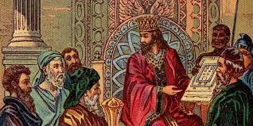
Biblical References in the Story
Magi : Already discussed
Algemeiner.com (google images)
According to biblical tradition (and some say myth), King Solomon was the third and last king in the ancient United Kingdom of Israel. Other faiths, such as Islam… , also embrace the notion of Solomon as a sagacious king and powerful prophet of Israel. He was renowned for his wisdom, his prolific writings, and his building accomplishments.
(https://www.worldhistory.org/solomon/

Slide 8
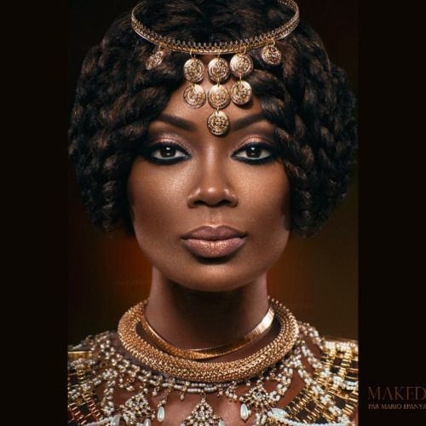
Queen of Sheba
(google images)
Queen of Sheba, Arabic Bilqīs, Ethiopian Makeda, (flourished 10th century BCE), according to Jewish and Islamic traditions, ruler of the kingdom of Sabaʾ (or Sheba) in southwestern Arabia. In the biblical account of the reign of King Solomon, she visited his court at the head of a camel caravan bearing gold, jewels, and spices. The story provides evidence for the existence of important commercial relations between ancient Israel and southern Arabia. According to the Bible, the purpose of her visit was to test Solomon’s wisdom by asking him to solve a number of riddles.
(https://www.britannica.com/biography/Queen-of-Sheba)

Slide 9
The two possessions of Della and James Dillingham Young.
the air shaft : ventilation shafts
depreciate : to (cause something to) lose value, especially over time
Janitor: caretaker of a building
Queen of Sheba
King Solomon
Both of them took mighty pride in the possessions.
One was Jim’s Gold Watch that had been his father’s and his grandfather’s.
The other was Della’s hair.
Had the Queen of Sheba lived in the flat across the air shaft, Della would have let her hair hang out of the window some day to dry just to depreciate Her Majesty’s jewels and gifts.
Had King Solomon been janitor, with all his treasures piled up in the basement, Jim would have pulled out his watch every time he passed, just to see him pluck at his beard from envy.

Slide 10
Della sold her beautiful hairs and bought Christmas Gift for Jim
“Will you buy my hair?“ asked Della. “I buy hair’, said Madame.
“Take your hat off and let’s have a sight at the looks of it.”
“Twenty Dollars,” said Madame, lifting the mass with a practiced hand.
The next moment, Della was searching for the stores for Jim’s present.
She found it at last. It surely had been made for Jim and no one else.
It was a platinum fob chain.
It was even worthy of the watch.
Della’s beautiful hair fell about her, rippling and shining like a cascade of brown waters. It reached below her knee and made itself almost a garment for her. And she did it her up again nervously and quickly. Once she faltered for a minute and stood still while a tear or two splashed on the worn red carpet.
Then she left to the market.
She stopped and red the sign, “ Mme. Sofronie, Hair Goods of All Kinds.

Slide 11
Please, God, make him think I am still pretty.
ravage: (v) to cause great damage to something
After buying the chain Della returned home. She came out of the intoxication.
“She got out her curling irons and lighted the gas and went to work repairing the ravages made by generosity added to love.”
Which is always a tremendous task, dear friends- a mammoth task.
She was looking wonderfully like a truant school boy.
She looked at her reflection carefully and critically.
At seven o’clock the coffee was made and the frying pan was on the back of the stove.
Della had the habit of saying little prayers about the simplest everyday things and now she whispered, “Please, God, make him think I am still pretty.

Slide 12
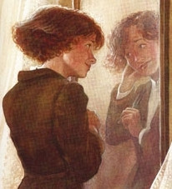
My hair grows awfully fast.
google images
Jim stopped inside the door, as immovable as a setter at the scent of quail. His eyes were fixed upon Della, and there was an expression in them that she could not read, and it terrified her. It was not anger, nor surprise, nor disapproval, nor horror, nor any of the sentiments that she had been prepared for. He simply stared at her fixedly with that peculiar expression on his face.
“Jim, darling,” she cried, “don't look at me that way. I had my hair cut off and sold it because I couldn't have lived through Christmas without giving you a present. It'll grow out again—you won't mind, will you? I just had to do it. My hair grows awfully fast. Say ‘Merry Christmas!’ Jim, and let's be happy. You don't know what a nice—what a beautiful, nice gift I've got for you.”

Slide 13
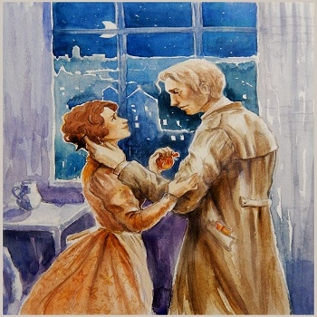
“You've cut off your hair?” asked Jim.
“Cut it off and sold it,” said Della. “Don't you like me just as well, anyhow? I'm me without my hair, ain't I?”
Jim looked about the room curiously.
“You say your hair is gone?” he said, with an air almost of idiocy.
“You needn't look for it,” said Della. “It's sold, I tell you—sold and gone, too. It's Christmas Eve, boy. Be good to me, for it went for you. Maybe the hairs of my head were numbered,” she went on with sudden serious sweetness, “but nobody could ever count my love for you. Shall I put the chops on, Jim?”
google images

Slide 14
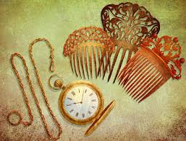
They show each other their Christmas Gifts
Google images
Jim drew a package from his overcoat pocket and threw it upon the table.
“Don't make any mistake, Dell,” he said, “about me. I don't think there's anything in the way of a haircut or a shave or a shampoo that could make me like my girl any less. But if you'll unwrap that package you may see why you had me going a while at first.”
White fingers and nimble tore at the string and paper.
For there lay The Combs—the set of combs, side and back, that Della had worshipped long in a Broadway window. Beautiful combs, pure tortoise shell, with jewelled rims—just the shade to wear in the beautiful vanished hair. They were expensive combs, she knew, and her heart had simply craved and yearned over them without the least hope of possession.
But she hugged them to her bosom, and at length she was able to look up with dim eyes and a smile and say: “My hair grows so fast, Jim!”

Slide 15
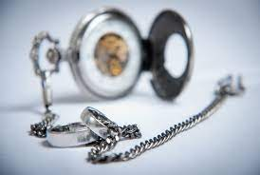
Platinum Fob Chain
google images
Jim had not yet seen his beautiful present. She held it out to him eagerly upon her open palm. The dull precious metal seemed to flash with a reflection of her bright and ardent spirit.
(It was a Platinum fob chain)
“Isn't it a dandy, Jim? I hunted all over town to find it. You'll have to look at the time a hundred times a day now. Give me your watch. I want to see how it looks on it.”
Instead of obeying, Jim tumbled down on the couch and put his hands under the back of his head and smiled.
“Dell,” said he, “let's put our Christmas presents away and keep ’em a while. They're too nice to use just at present. I sold the watch to get the money to buy your combs. And now suppose you put the chops on.”

Slide 16
Two foolish children in a flat who most unwisely sacrificed for each other the greatest treasures of their house.
FarsiNet.Inc (google images)
The magi, as you know, were wise men wonderfully wise men—who brought gifts to the Babe in the manger. They invented the art of giving Christmas presents. Being wise, their gifts were no doubt wise ones, possibly bearing the privilege of exchange in case of duplication. And here I have lamely related to you the uneventful chronicle of two foolish children in a flat who most unwisely sacrificed for each other the greatest treasures of their house. But in a last word to the wise of these days let it be said that of all who give gifts these two were the wisest. Of all who give and receive gifts, such as they are wisest. Everywhere they are wisest. They are the magi.

